Slide 1
Intro to Statistics to Assess Randomized Algorithms
Dr. Andrea Arcuri
Prof. of Software Engineering
Kristiania University College, Oslo, Norway
Oslo Metropolitan University, Oslo, Norway

Slide 2
In This Seminar
Why using statistics?
Basic statistics
eg, Wilcoxon-Mann-Whitney U-test
Examples in R
If time… automate table generation in Latex
ie, avoid filling data by hand
add statistics with just couple of lines of code…

Slide 3
Just an informal intro for beginners…
quite complex topic if you look at the details…

Slide 4
Focus on comparisons of testing techniques, tools and algorithms
For empirical studies with human subjects, things are bit different… (eg, constraints on sample size)

Slide 5
Why bother with statistics?

Slide 6
Experiments
Evaluate if new technique A is better than B
eg, compared to the state-of-the-art
code coverage, fault detection, etc
Large experiments can be too time consuming
Not just software testing
most branches of engineering and science (medicine, biology, etc.)

Slide 7
Statistics: have I run enough experiments?

Slide 8
Randomised Algorithms
Run twice, can get different results
Many different kinds
Random Testing (RT)
Search-Based Software Testing (SBST)
Some kinds of Dynamic Symbolic Execution (DSE)
etc
How many N runs with different seeds?

Slide 9
Case Study Selection
Space Z of possible problem instances
On some instances, technique A works fine (eg better than B), but not on others
How many N instances from Z to use?
How can you select?
even if unbiased, maybe you just got lucky…
Still probability involved

Slide 10
Motivating Example
Two algorithms, A and B
Run n=10 times, or 1 on n=10 different instances
Binary output: pass or fail
A: successful 7 times
B: successful 5 times
20% of success rate difference
Is A better than B???

Slide 11
Probability
Probability p in [0,1] of:
a successful run in a randomised algorithm
sampling/choosing an instance for which algorithm is successful
k successes out of n runs/instances
n-k failures
order of k and n-k does not matter
estimated success rate of p: r=k/n
for n to infinite, r would converge to p

Slide 12
Binomial Distribution B(n,r)
What is the probability P of having k successes when I have n instance/runs with success rate r?
P(B(n,r)=k) = bin(n,k) * r^{k} * (1-r)^{(n-k)}
any order
k successes
n-k failures

Slide 13
Examples
In R, “dbinom(k,n,r)”
P(B(10,0.7)=7) = 0.26
If real success rate is 70%, then there is only a 26% probability of obtaining 7 successes out of 10 runs/instances
But what if actual success rate was 50%?
P(B(10,0.5)=7) = 0.11
26% > 11%, but still 11% not so unlikely…

Slide 14
The most likely estimate r=k/n might not have high probability of being correct

Slide 15
Comparing A with B
A: P(B(10,0.7)=7) = 0.26
B: P(B(10,0.5)=5) = 0.24
P(B(10,.7)=7) * P(B(10,.5)=5) = 0.06
only 6% probability that, if X has success rate 70% and Y has 50%, then X obtains 7 successes and Y 5

Slide 16
But what if…
… A and B have exactly same success rate 60%?
ie, got bit lucky with A, and bit unlucky with B
P(B(10,.6)=7) * P(B(10,.6)=5) = 0.04
4% not so huge difference from 6%…
What if B is actually better?
less likely, but still possible

Slide 17
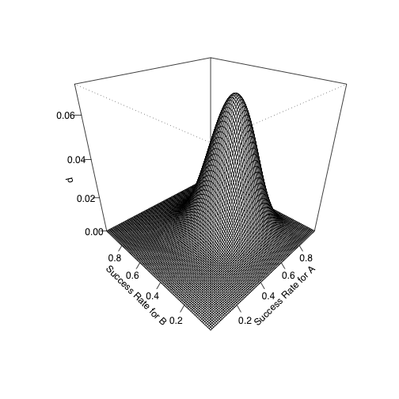
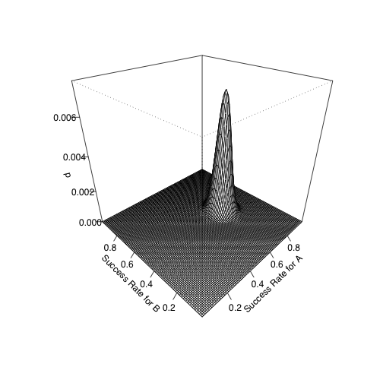
Probability (Z axis) of getting 70% successes with A and 50% for B for different success rates of A and B (X and Y axes)
>0% that B is better
extremely unlikely that B was better
n=10
A: k=7
B: k=5
n=100
A: k=70
B: k=50

Slide 18
Don’t need math details…
Statistical test will tell you:
70% and 50% are not really significant if n=10
But strongly significant if n=100
Important to know when and which statistical tests to use
eg, in this example, Fisher Exact Test

Slide 19
compareAB_n10 <- function(){
n = 10
ka = 7
kb = 5
m = matrix(c(ka,n-ka,kb,n-kb),2,2)
fisher.test(m)
}
compareAB_n100 <- function(){
n = 100
ka = 70
kb = 50
m = matrix(c(ka,n-ka,kb,n-kb),2,2)
fisher.test(m)
}

Slide 20
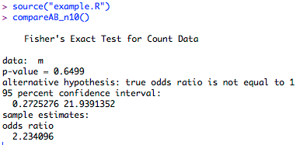
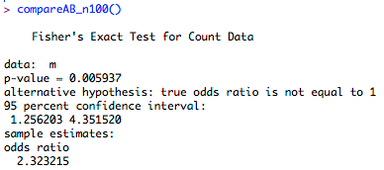
p-value can give you an hint on whether you can say the two compared A and B are different
eg, < 0.05

Slide 21
What Statistical Tools to Use?
Many options, open-source and commercial
Two most used/popular: R and Python
R: open source, specific for statistics, large community
Python: open source, general scripting language, good libraries for statistics

Slide 22
How to Choose?
If you already know Python outside of statistics, go for Python
If not, R might be safest option (de-facto standard)
Both language have their quirks
Personally I use R, but it does not mean R is a good language…
Most important feature: need to have scripting, not just a GUI

Slide 23


Slide 24
Programming with a dynamically typed language (eg, R and Python) can be a painful experience…
… but scripts for statistics are usually short and not complex…
… and re-used paper after paper…

Slide 25
Statistical Tests

Slide 26
Statistical Difference
Are A and B different?
Type I Error:
Claiming difference when no difference
Statistical tests give p-value
P-value: probability of committing Type I error
eg, p-value=0.1 means 10% chance to be wrong if state two algorithms are different
more formally, probability of observing the data if the null hypothesis is true

Slide 27
P-value < 0.05
“Often”, statistically significant if < 0.05
Rule of thumb: do not claim difference unless you are very sure…
Completely arbitrary threshold
Why not 1%? Or 10%?
In decision problems, you need to make a choice anyway…
eg choose technique/tool to test software
Just report the p-values…

Slide 28
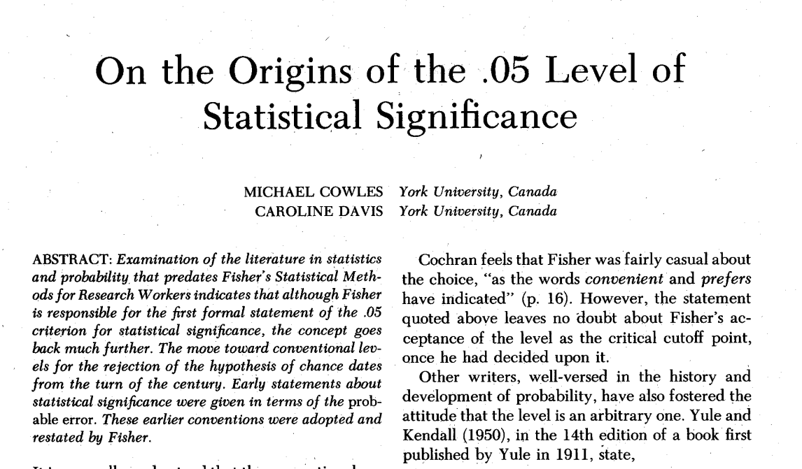

Slide 29
More than 100 years old
Student [W. S. Gosset]. The probable error of a mean. Biometrika, 1908
about t-test: “three times the probable error in the normal curve, for most purposes, would be considered significant”
Fisher, R. A. Statistical methods for research workers. Edinburgh: Oliver & Boyd, 1925.
just rounding 0.0456 to 0.05
“rejection level of 3PE is equivalent to two times the SD (in modern terminology, a z score of 2)”

Slide 30
Tests You Need To Know
If binary (eg success rates): Fisher Exact test
Otherwise: Wilcoxon-Mann-Whitney U-test
Student t-test most known, but you shouldn’t use it…

Slide 31
Fisher Exact Test
In R: fisher.test(m)
m is a 2x2 matrix
Check if can claim different success rates
# Success for A | # Failures for A
# Success forB | # Failures for B

Slide 32
Example
Automated Bug Fixing
You somehow sample N bugs to repair, with as little bias as possible
Want to know if your novel technique A is better than state of the art B
Run experiments with N=30
A repairs 20, whereas B repairs 15
Can claim with high confidence that A is better?

Slide 33
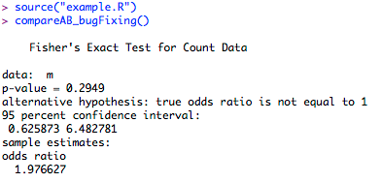
compareAB_bugFixing <- function(){
n = 30
ka = 20
kb = 15
m = matrix(c(ka,n-ka,kb,n-kb),2,2)
fisher.test(m)
}

Slide 34
But does it matter that not enough evidence to claim A is better?

Slide 35
Not really…
Evidence of 5 bugs fixed by A but not B
Can’t say A is better, but can say A is useful
Techniques can be combined/integrated
Given a domain (eg bug fixing), no single paper can solve all instances

Slide 36
“Similar” Example
Still Automated Bug Fixing
Now A and B are randomised (eg Genetic Programming)
Single bug, run experiments 30 times
A repairs 20 times, whereas B repairs 15 times
Can claim with high confidence that A is better?
Can claim that A is useful?

Slide 37
Bit different now…
A better? No (recall high p-value 0.29)
A useful? Arguably no, i.e. equivalent to B
In this case, warranted to run some more experiments before trying to publish it…

Slide 38
But what if…
… I am comparing randomised algorithms on many problem instances?
Typical case of SBST and when comparing with RT

Slide 39
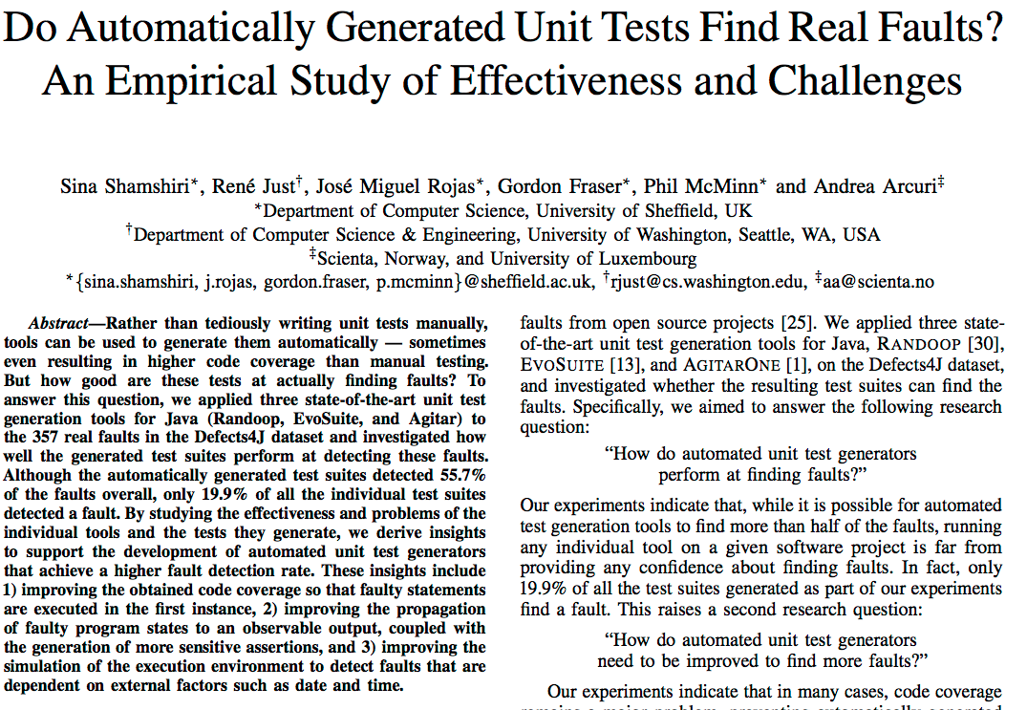

Slide 40
Context
Generate tests that can trigger bug
357 bugs from Defect4J
Three compared tools
Agitar: commercial, 1 run per bug
Randoop: open-source, randomized, 10 runs per bug
EvoSuite, open-source, randomized, 10 runs per bug

Slide 41
Results
Bugs found only by…
Agitar: 28
Randoop: 12
EvoSuite: 35
No technique subsumes the others
In many cases, Randoop/EvoSuite found bug only in a subset of the 10 runs…

Slide 42
So 2 Steps Analysis
On single instances to check A vs B performance
need to take into account randomness
On whole case study
based on how was selected, from random sample can infer/estimate performance on whole domain
more on this later…

Slide 43
Non-Binary Performance
Not just binary success and failure
Performance metrics as numerical values
branch coverage in test generation, e.g. 75% vs 42%
number of test executions in regression testing
etc
Usually looking at aggregated values, like mean and median

Slide 44
Student t-test
Used to compare mean (average) values of two distributions
It requires normality of data, but…
“The assumptions of most mathematical models are always false to a greater or lesser extent”
Glass G, Peckham P, Sanders J. Consequences of failure to meet assumptions underlying the fixed effects analyses of variance and covariance. Review of Educational Research 1972; 42(3):237–288.

Slide 45
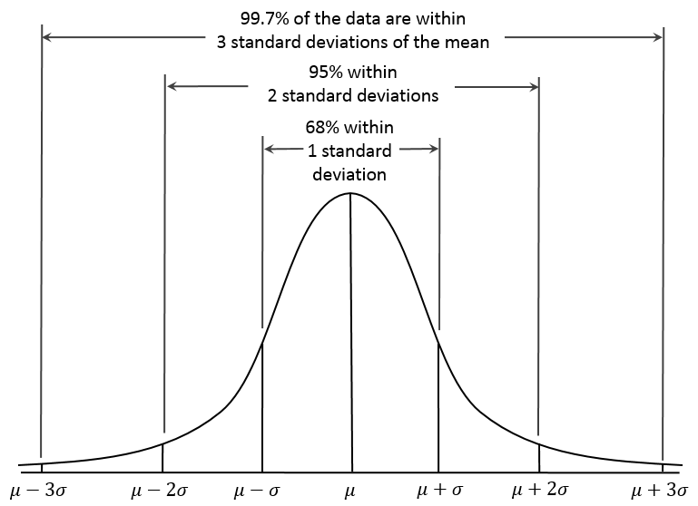
Normal Distribution
Fully defined by two properties: mean and standard deviation
Many phenomena in nature fit in a normal distribution

Slide 46
Example
Generating n test cases before finding bugs
Randomised algorithm, so n can be represented as random variable
Can n be normally distributed?
NEVER: n<0 is impossible, and discrete value (ie, no fraction of tests, e.g. 1.3)

Slide 47
t-test (continued.)
The Central Limit Theorem (CLT) states that the sum of n random variables converges to a normal distribution as n increases
t-test internally uses sums of random variables
Often, already with n=30 the t-test is robust to deviation from normality

Slide 48
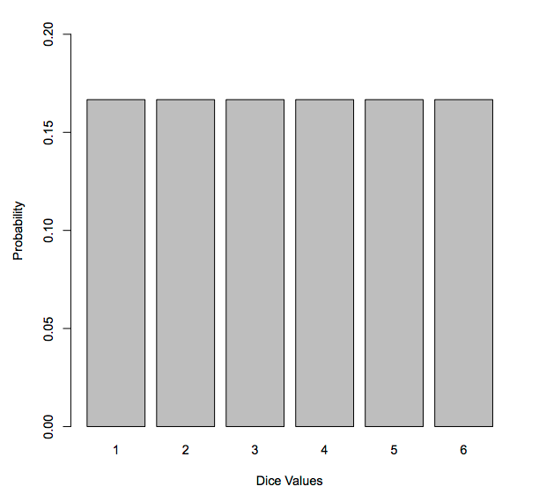
CLT Example
Rolling a dice
What is probability distribution of a 6 face dice?
Each value has 16% probability
Definitively not normal

Slide 49
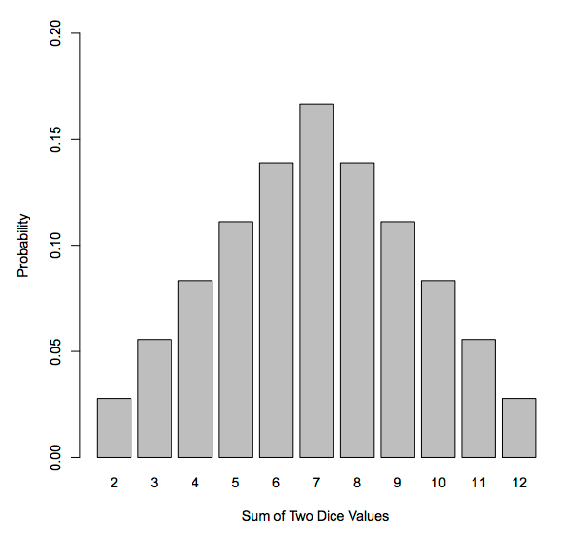
CLT (continued.)
But what is the probability of the sum of n dices?
Even with as low as n=2, it starts to look normal…

Slide 50
A More Relevant Example
Unit test generation (EvoSuite) for code coverage
Sample 100 projects at random from SourceForge (the SF100 corpus)
yep, that is from before GitHub…
Coverage [0%,100%] for single classes
Average/mean coverage on the 100 projects
recall sum of n variables divided/scaled by n

Slide 51
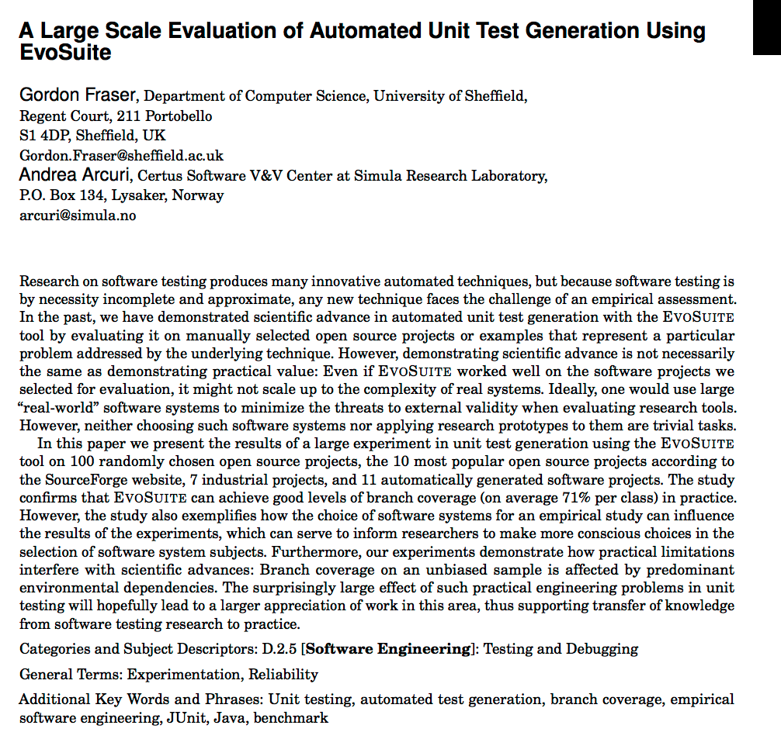

Slide 52
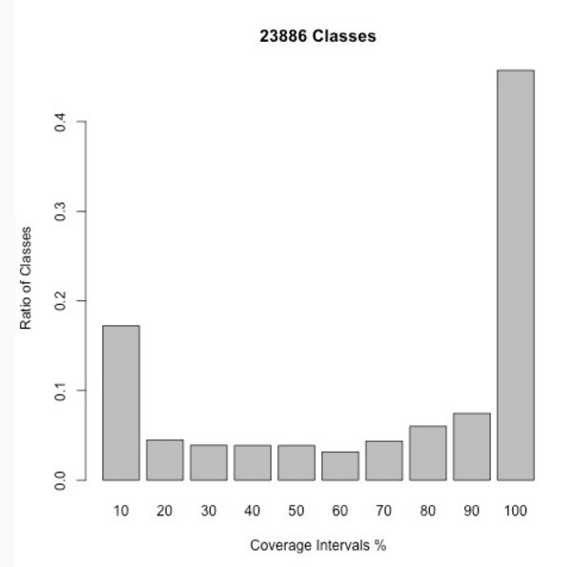
Probability Distribution
Single classes
Many (40%) are trivial, cov > 90%
Some (20%) are too difficult, cov < 10%
Does not look normally distributed…

Slide 53
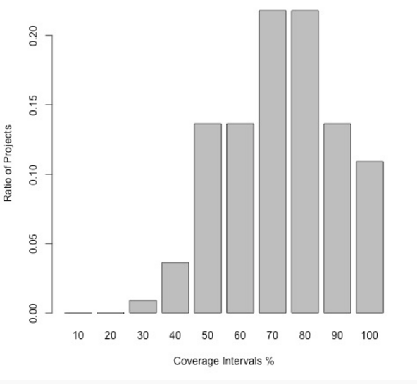
(continued.)
Average on each of the projects
Start to resemble a normal distribution
Interestingly, same distribution when looking at the used industrial systems

Slide 54
What about checking normality?
Check normality before using t-test
Shapiro-Wilk test
hypothesis normality, p-value to check if can reject it
Few problems with this approach:
increase error, as doing 2 tests now
small n: everything looks normal
some algorithms have known non-normal distributions

Slide 55
Random Testing
Often used as a baseline when evaluating new techniques
Easy to implement, in some cases can give good results
Eg, sample n test cases until trigger a bug
n follows a geometric distribution, not a normal one

Slide 56
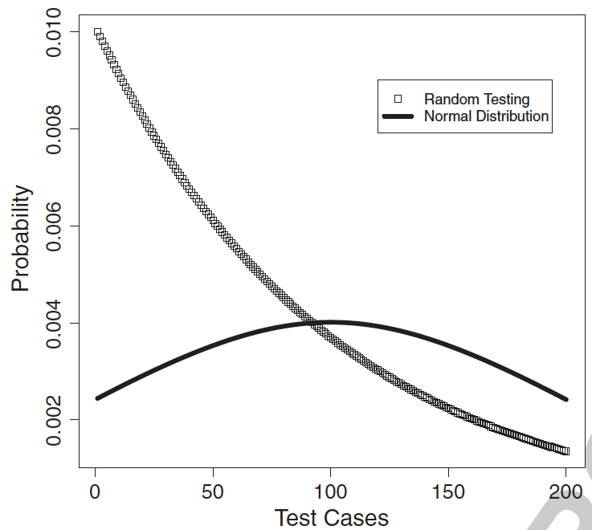
Example of geometric (RT) and normal distribution with same mean and standard deviation (failure rate 0.01)

Slide 57
Non-Parametric Tests
Do not make assumptions on distributions
“Safer” to use
Downsize: usually (not always) less powerful, i.e. more difficult to detect statistical difference

Slide 58
Wilcoxon-Mann-Whitney U-test
Check if two distributions A and B have same stochastic order
Ie, when sampling: P(A > B) = P(B > A)
Look at relative order of sampled elements, and not their absolute values
Robust to outliers

Slide 59
Example
A | 1 | 2 | 3 | 4 | 5 | 6 | 49
B | 7 | 8 | 9 | 10 | 11 | 12 | 13
All values in B are greater than A, but for 49
Assuming larger values are better, are A and B equivalent? Or is one better?
What would statistical tests say here?

Slide 60
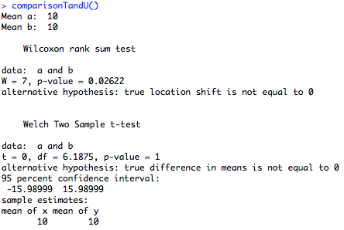
comparisonTandU <- function(){
a = c(1,2,3,4,5,6,49)
b = c(7,8,9,10,11,12,13)
cat("Mean a: ", mean(a), "\n")
cat("Mean b: ", mean(b), "\n")
print(wilcox.test(a,b))
print(t.test(a,b))
}
Strong difference for U-test
Same mean 10, so no difference for t-test

Slide 61
Which One To Use?
If few data (ie low n):
t-test might not be robust to deviation from normality
U-test might be not enough powerful
If lot of data
t-test fine even if data is not normal (Central Limit Theorem)
U-test becomes enough powerful

Slide 62
(continued.)
If not enough data
need to study details of statistics, and choose the right test
eg, empirical study with 20-30ish students
If lot of data
does not matter so much what you use (eg t-test vs. U-test)
eg, test data generation on cluster of computers

Slide 63
So If In Doubts…
… just try to increase the amount of data!
run experiments for longer
use cluster of computers
Not always possible:
human subjects
industrial case studies

Slide 64
In a Nutshell…
Main purpose of statistics is to handle limited amount of data, when is expensive to acquire
eg, medical trials for new drugs
When can run large experiments, statistics becomes less important

Slide 65
Side-effects
With a lot of data…
… every difference, even if tiny, becomes statistically significant
eg, very easy to get p-value < 0.05

Slide 66
Wrong Approach
Run experiments
Compare A with B
Use statistics
p-value < 0.05 (or any other threshold)
Claim contribution because results are statistically significant

Slide 67
A Better Approach
Run experiments on A and B
Is the difference of practical significance?
this is problem dependent, e.g. enough branch coverage improvement
If yes: do statistical tests to check if you had enough data
If not: who cares of p-values…

Slide 68
How to Quantify Practical Relevance?
Problem dependent
improvement in branch coverage
Often, given a measure K, compare average of K(A) with K(B) over all instances
eg, 67% vs 72% coverage

Slide 69
Issues With Averages
diff = mean(K(A)) - mean(K(B))
Would ignore variability in the data
eg if high standard deviation
Improvement from 1% to 3% is not the same as from 91% to 93%, although still diff=2%
Issue if different order of measures, e.g.
easy problems: e.g. A=10 vs B=20 test cases
difficult problems: e.g. A=200,000 vs B=100,000
Skewed results if outliers

Slide 70
Standardised Effect Sizes
Independent from unit of measure
robust if high variability in the instances of the case study
Single measure, which takes into account also variability
Easier to compare among studies

Slide 71
Main Effect Sizes
Odds Ratio
for dichotomous results (eg success/failure)
Cohen d
most known, but “makes sense” only if data is normal, so quite seldom… plus, difficult to interpret
Vargha and Delaney A12 measure
non-parametric, very easy to interpret
personally, the one I use 99% of the times…

Slide 72
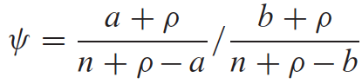
Odds Ratio
“measure of how many times greater the odds are that a member of a certain population will fall into a certain category than the odds are that a member of another population will fall into that category”

Slide 73
(continued)
If same success rate, odds ratio = 1
Automatically computed with Fisher test

Slide 74
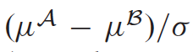
Cohen d
Difference in mean divided by pooled standard deviation
Larger mean difference: greater d
Smaller standard deviation: greater d
If no difference, d=0

Slide 75
(continued.)
standard deviation (SD) has special characteristics in normal distribution
but in other distributions, dividing by SD can be meaningless

Slide 76
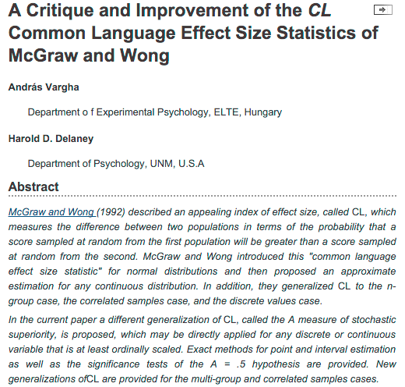

Slide 77
Vargha-Delaney A Measure
Non-parametric
A12 defines probability [0,1] that running algorithm (1) yields higher values than running another algorithm (2).
If the two algorithms are equivalent, then A12=0.5
Eg, A12=0.7 means 70% probability that (1) gives better results

Slide 78
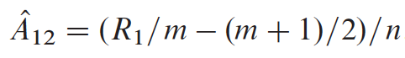
(continued.)
R1 is the rank sum of the values of (1)
eg, A={42,11,7} and B={1,20,5}, then R1=sum(6,4,3)=13
m=|A|, and n=|B|, usually m=n
Limitation: A12 tells you how often better results, but not by how much

Slide 79
R Code For A12 Measure
measureA <- function(a,b){
r = rank(c(a,b))
r1 = sum(r[seq_along(a)])
m = length(a)
n = length(b)
A = (r1/m - (m+1)/2)/n
return(A)
}

Slide 80
On t-test vs. U-test
Both are fine for statistical tests
Can interpret U-test with A12
If data not normal, t-test is still fine (Central Limit Theorem), but NOT the Cohen d
Having A12 is a good reason to choose U-test over t-test
Still can use both (they measure different things)

Slide 81
For Large Experiments…
p-values get smaller and smaller
NOT the standardised effect sizes
they just get more precise
you ll not see much difference between n=100 and n=1,000,000

Slide 82
The Wrath of Bonferroni
When running several tests, increase Type I error
ie high probability of wrongly rejecting at least one null hypothesis
Bonferroni adjustment: reduce threshold for statistical significance based on number k of tests
eg 0.05/k
I NEVER use it (long story)… but, if reviewers ask for it…

Slide 83
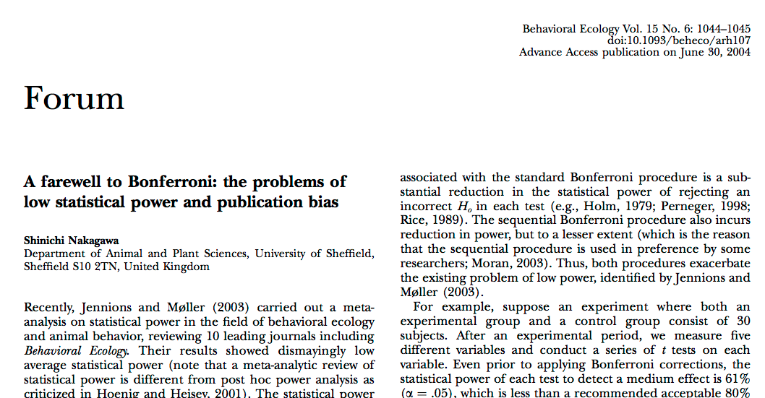

Slide 84
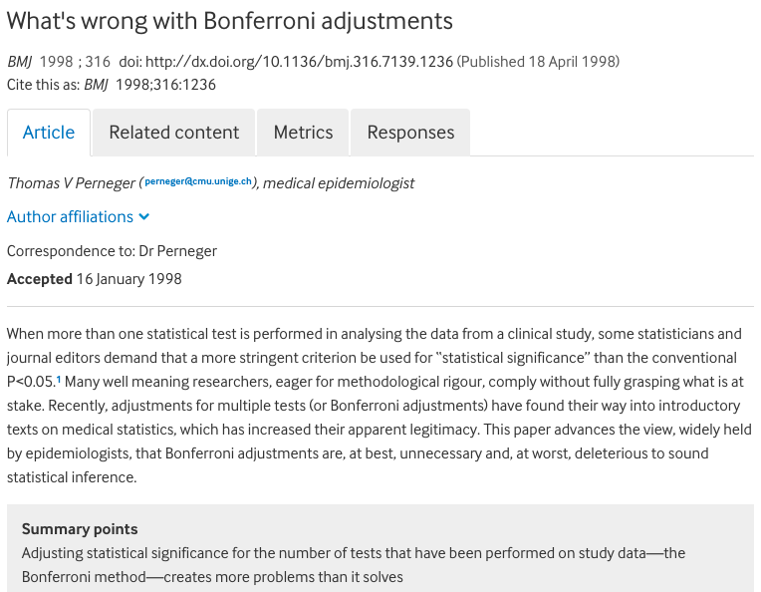

Slide 85
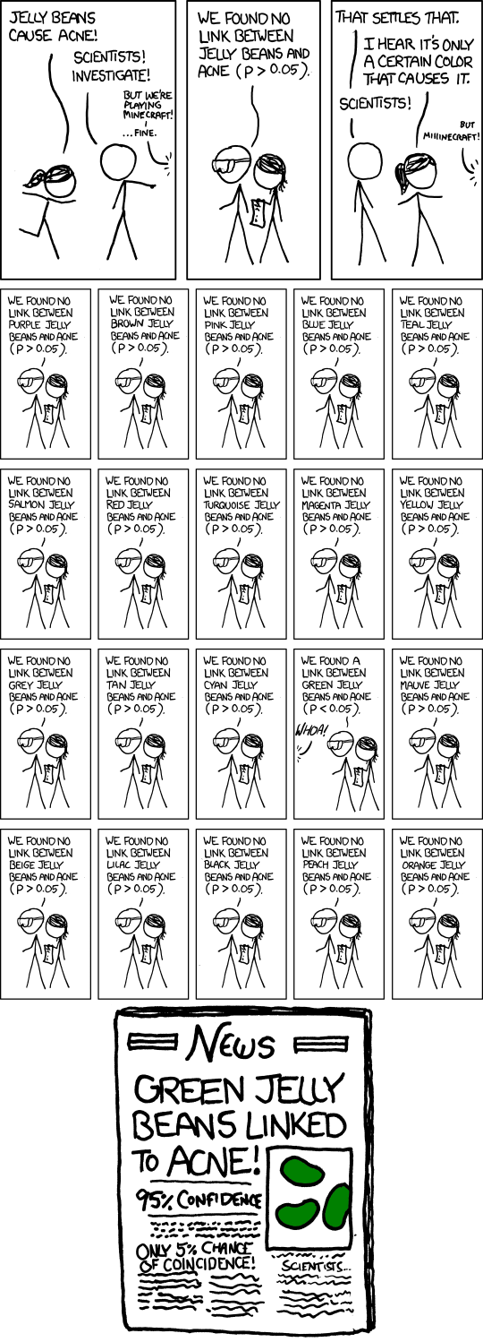
Beware…
When running many separated experiments, can get low p-value by chance…
In these cases, single instances should not matter, but rather how often they happen
need to look at whole picture
https://xkcd.com/882/

Slide 86
Multiple Experiments
Collection of N instances
eg, 20 open-source projects
If randomised algorithm, repeat each experiment K times on each instance
Very typical scenario
How to choose N vs K?
What statistics to use?

Slide 87
Controversial Topic…
You might read a lot of different opinions…
eg, on the use of Bonferroni
Try to have big N, but at least K=10 (better 30)
On each of N instance, apply basic test (eg U-test)
Count and report number of instances with statistical difference (eg, at arbitrary 0.05)
both positive and negative (ie improvements vs worse results)

Slide 88
More Positive or Negative Cases?
Calculate effect size A12 on each of the N instances
Report average/median effect sizes
Statistics on whether the N values of A12 are symmetric around 0.5
wilcox.test(c(a1,a2,a3,…,an), mu=0.5)

Slide 89
Bayesian Data Analysis
I am no expert on this…
Every time I speak about statistics, I often get asked about it
Bayesian statistics currently promoted as a “better alternative” to frequentist statistics (eg p-values)

Slide 90
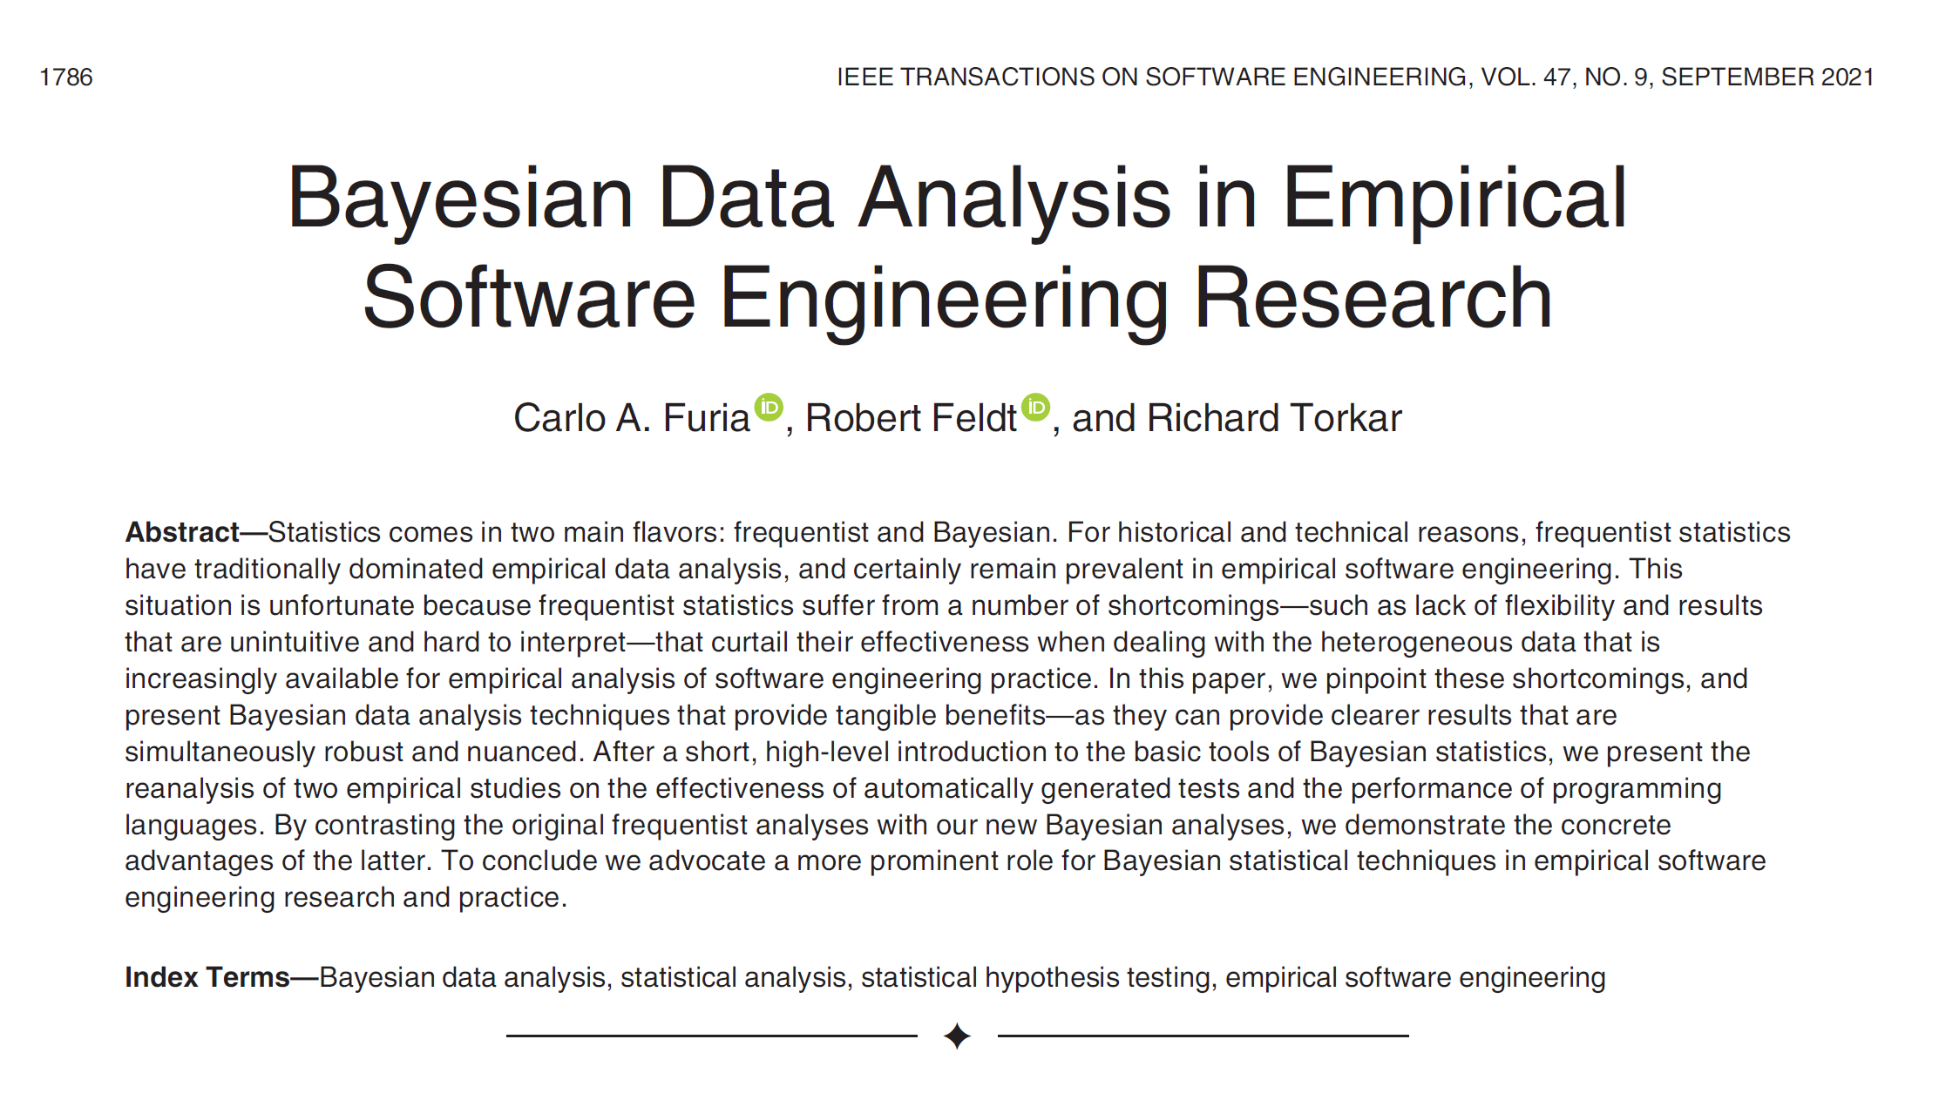

Slide 91
My Personal Opinion…
I do not particularly like it…
Trading a set of problems (eg P(D|H0)!=P(H0|D)) with another set of problems (choice of prior distributions)
Harder to use / setup
Might have good applications, but not so sure about randomized algorithms
I would need to see better evidence on this

Slide 92
How To Visualise The Data and Results of the Statistical Tests?

Slide 93
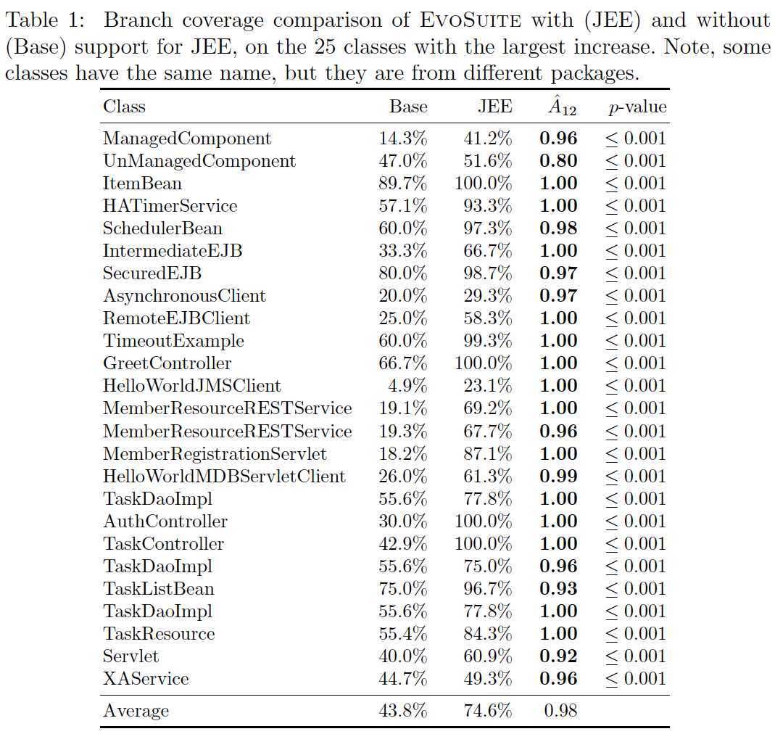
Java Enterprise Edition Support in Search-Based JUnit Test Generation, Arcuri and Fraser, SSBSE’16

Slide 94
Tables
Good way to show statistical tests
a row for each problem instance (if not too many)
a column for effect size (in bold if p-value < 0.05)
a column for p-value
a final row with average values
Of course, many more options (eg, graphs, boxplots, etc.)

Slide 95
Raise Your Hand If…
you have ever filled a table by hand, e.g. in Microsoft Word, and …
data is invalid, get new data, refill table by hand…
… again and again…
(extra points if at 4am of a conference deadline night)

Slide 96
DO NOT DO IT
Unless it is trivial small (eg 2x2 table)
Very error prone (especially at 4am)
If you see colleague/student doing it, hit them
or use any other form of punishment legal in your country
they will be grateful, one day…
Invest time in learning Latex and R
or any other equivalent combination

Slide 97
From Scripts to PDF
Given some data X on file (eg CSV)
Use scripts (R/Python) to load it
Create “textual” representation of table, and save it to a file K
Automatically import K in your paper document (eg if written in Latex)
Generate PDF from your paper document

Slide 98
paper.tex
\begin{table}[t!]
\centering
\caption{\label{table:selection}
Branch coverage comparison of \evo with (JEE) and without (Base)
support for JEE, on the 25 classes with the largest increase.
Note, some classes have the same name, but they are from different packages.
}
\scalebox{0.85}{
\input{generated_files/tableSelection.tex}
}
\end{table}
To get a better picture of the importance of handling JEE features,
Table~\ref{table:selection} shows detailed data on the 25 challenging
classes where JEE handling had most effect: On these classes, the

Slide 99
\begin{tabular}{ l @{\hspace{0.5cm}}r@{\hspace{0.5cm}}r@{\hspace{0.5cm}} r@{\hspace{0.5cm}}r }\toprule
Class & Base & JEE & $\hat{A}_{12}$ & $p$-value \\
\midrule
ManagedComponent & 14.3\% & 41.2\% & {\bf 0.96} & {\bf $\le 0.001$} \\
UnManagedComponent & 47.0\% & 51.6\% & {\bf 0.80} & {\bf $\le 0.001$} \\
ItemBean & 89.7\% & 100.0\% & {\bf 1.00} & {\bf $\le 0.001$} \\
HATimerService & 57.1\% & 93.3\% & {\bf 1.00} & {\bf $\le 0.001$} \\
SchedulerBean & 60.0\% & 97.3\% & {\bf 0.98} & {\bf $\le 0.001$} \\
IntermediateEJB & 33.3\% & 66.7\% & {\bf 1.00} & {\bf $\le 0.001$} \\
SecuredEJB & 80.0\% & 98.7\% & {\bf 0.97} & {\bf $\le 0.001$} \\
AsynchronousClient & 20.0\% & 29.3\% & {\bf 0.97} & {\bf $\le 0.001$} \\
RemoteEJBClient & 25.0\% & 58.3\% & {\bf 1.00} & {\bf $\le 0.001$} \\
TimeoutExample & 60.0\% & 99.3\% & {\bf 1.00} & {\bf $\le 0.001$} \\
GreetController & 66.7\% & 100.0\% & {\bf 1.00} & {\bf $\le 0.001$} \\
HelloWorldJMSClient & 4.9\% & 23.1\% & {\bf 1.00} & {\bf $\le 0.001$} \\
MemberResourceRESTService & 19.1\% & 69.2\% & {\bf 1.00} & {\bf $\le 0.001$} \\
MemberResourceRESTService & 19.3\% & 67.7\% & {\bf 0.96} & {\bf $\le 0.001$} \\
MemberRegistrationServlet & 18.2\% & 87.1\% & {\bf 1.00} & {\bf $\le 0.001$} \\
HelloWorldMDBServletClient & 26.0\% & 61.3\% & {\bf 0.99} & {\bf $\le 0.001$} \\
TaskDaoImpl & 55.6\% & 77.8\% & {\bf 1.00} & {\bf $\le 0.001$} \\
AuthController & 30.0\% & 100.0\% & {\bf 1.00} & {\bf $\le 0.001$} \\
TaskController & 42.9\% & 100.0\% & {\bf 1.00} & {\bf $\le 0.001$} \\
TaskDaoImpl & 55.6\% & 75.0\% & {\bf 0.96} & {\bf $\le 0.001$} \\
TaskListBean & 75.0\% & 96.7\% & {\bf 0.93} & {\bf $\le 0.001$} \\
TaskDaoImpl & 55.6\% & 77.8\% & {\bf 1.00} & {\bf $\le 0.001$} \\
TaskResource & 55.4\% & 84.3\% & {\bf 1.00} & {\bf $\le 0.001$} \\
Servlet & 40.0\% & 60.9\% & {\bf 0.92} & {\bf $\le 0.001$} \\
XAService & 44.7\% & 49.3\% & {\bf 0.96} & {\bf $\le 0.001$} \\
\midrule
Average & 43.8\% & 74.6\% & 0.98 & \\
\bottomrule
\end{tabular}

Slide 100
bestSelectionTable <- function(){
dt <- read.table(gzfile(SELECTION_ZIP_FILE),header=T)
TABLE = paste(GENERATED_FILES,"/tableSelection.tex",sep="")
unlink(TABLE)
sink(TABLE, append=TRUE, split=TRUE)
cat("\\begin{tabular}{ l @{\\hspace{0.5cm}}r@{\\hspace{0.5cm}}r@{\\hspace{0.5cm}} r@{\\hspace{0.5cm}}r }\\toprule","\n")
cat("Class & Base & JEE & $\\hat{A}_{12}$ & $p$-value \\\\","\n")
cat("\\midrule","\n")
Bv = c(); Fv = c(); Av = c()
selection = getBestClassesSelection(dt,25)
projects = sort(unique(dt$group_id))
for(proj in projects){
classes = unique(dt$TARGET_CLASS[dt$group_id==proj])
classes = sort(classes[areInTheSubset(classes,selection)])
for(cl in classes){
mask = dt$group_id==proj & dt$TARGET_CLASS==cl
base = dt$BranchCoverage[mask & dt$configuration_id=="Base"]
pafm = dt$BranchCoverage[mask & dt$configuration_id=="JEE"]
a12 = measureA(pafm,base)
w = wilcox.test(base,pafm,exact=FALSE,paired=FALSE)
pv = w$p.value
if(is.nan(pv)) {pv = 1}
stat = pv < 0.05
if(pv < 0.001){ pv = "\\le 0.001"
} else { pv = formatC(pv,digits=3,format="f")}
cat(getClassName(cl))
cat(" & “); cat(formatC(100*mean(base),digits=1,format="f"),"\\%",sep="")
cat(" & “); cat(formatC(100*mean(pafm),digits=1,format="f"),"\\%",sep="")
a12Formatted = formatC(a12,digits=2,format="f")
cat(" & ")
if(!stat) {
cat(a12Formatted, " & ")
cat("$",pv,"$",sep="")
} else {
cat("{\\bf ",a12Formatted,"} & ",sep="")
cat("{\\bf $",pv,"$}",sep="")
}
cat(" \\\\ \n")
Bv = c(mean(base),Bv)
Fv = c(mean(pafm),Fv)
Av = c(a12,Av)
}
}
cat("\\midrule","\n")
avgB = paste(formatC(100*mean(Bv),digits=1,format="f"),"\\%",sep="")
avgF = paste(formatC(100*mean(Fv),digits=1,format="f"),"\\%",sep="")
avgA = formatC(mean(Av),digits=2,format="f")
cat("Average & ", avgB," & ",avgF," & ",avgA," & \\\\ \n")
cat("\\bottomrule","\n")
cat("\\end{tabular}","\n")
sink()
}
analyze.R
actual statistics is just couple of lines

Slide 101
When generating tables/graphs in R/Latex, adding statistics is trivial!
Data change? No problem:
$> bestSelectionTable()
$> pdflatex paper.tex

Slide 102
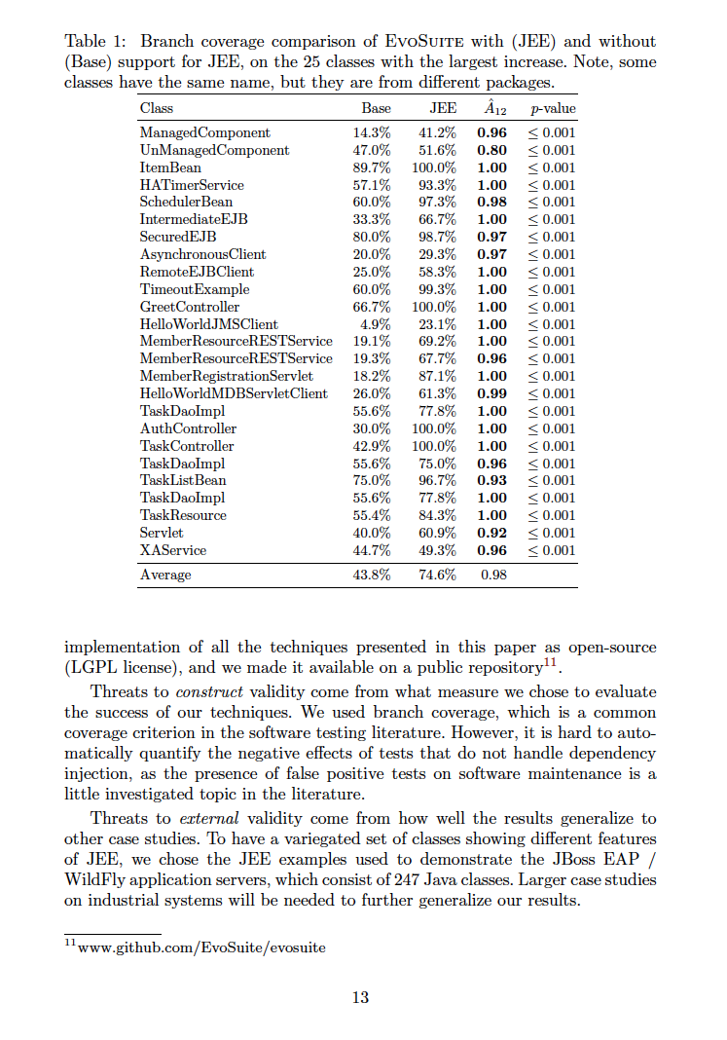

Slide 103
ROI of learning Latex/R
Steep learning curve
Will save you lot of time, year after year
Most analyses in the papers are similar
i.e. copy&paste R scripts from paper to paper
If you are doing a PhD in Software Engineering, writing 50-100 lines of R should not be a big problem…

Slide 104
Conclusion
Just a brief, high level introduction
Many more things to cover
Few take away lessons…

Slide 105
(1) Statistics Is Not Mumbo Jumbo
If used in all fields of science and engineering for more than 100 years, there must be a reason…
ISSTA’13 review: “…1217 is simply a statistically estimated (not real) lower bound based on inspection of only 20 classes! The authors should just report exactly what they confirmed on the sampled 20 cases rather than using statistically estimated numbers.”
… not a big deal, you just submit to EMSE…

Slide 106
(2) The more data,
the better
If in doubt…
t-test or U-test?
Is it wrong to skip Bonferroni?
Do I really have to learn all that math stuff?
Well, the more data, the less important the statistical tests become
If can’t have experiments with 1000 students (or industrial systems), maybe can on 1000 open-source projects

Slide 107
(2.1) Corollarium
Learn how to use clusters of computers for experiments
Many universities do have them
Usually just need a 10-30 lines of Bash script…

Slide 108
(3) Main Statistics To Use
Fisher Exact test with odds ratio
U-test with A12 effect sizes
There are more, but those are good starting points
Remember 0.05 threshold is arbitrary…

Slide 109
(4) Automation
Automate the generation of tables/graphs
Learn R/Python and Latex
When generation is automated, adding statistics takes just a couple of minutes

Slide 110


